Slide 1
Assessment: Who? What? Why?
Brad Thiessen
WASC Re-Accreditation Kick-Off Event & Training
Friday, July 26, 2013

Slide 2
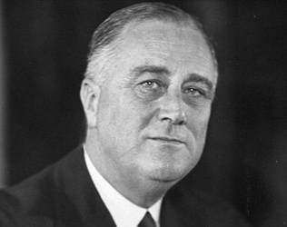
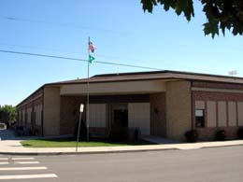
Who?

Slide 3
Who?

Slide 4
Why?
“… prepare graduates to live, work, and learn as active members of a global society.”
Mission fulfilled?
What contributes?

Slide 5
Why?
Purpose: To provide useful feedback to benchmark and improve institutional effectiveness.
Values:
* Useful, timely
* Efficient, feasible
* Meets internal and external needs
* Sustained by faculty/staff; supported by leadership
* Synthesizes info from existing and new instruments
* Continuously evaluated and improved

Slide 6
What?
Define what you intend students to gain as a result of a program
Determine the degree to which students attain what you intended
Determine the impact of program activities on student development
Document & use evidence for improvements

Slide 7
What we intend for students
student
learning
program (PLOs) .
institutional (ILOs) .
course (CLOs) .
outcomes
or
objectives
Clear statements of the knowledge, skills, or attitudes we intend for students to gain and demonstrate

Slide 8
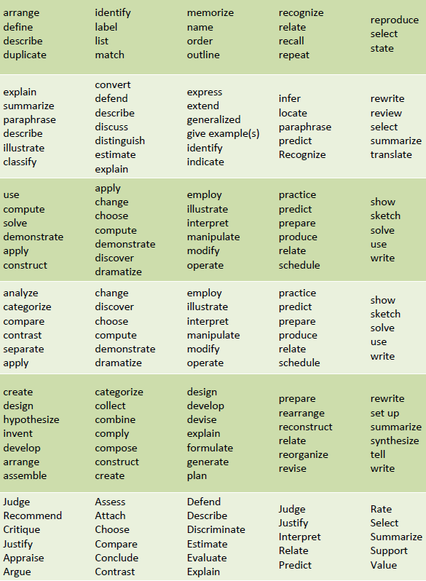
Students will identify the purpose of assessment
Students will design a scheme to critique outcomes and provide feedback.
Given a Friday afternoon presentation on assessment, audience members will stay awake for at least 30 minutes

Slide 9
Students attain what we intend?
Instruments & Methods
Indirect |  | Direct
Do you feel as though you were able to stay awake for at least 30 minutes? |  | Record the number of people who have at least one eye open after 30 minutes
Valid decisions Assessment Quality

Slide 10
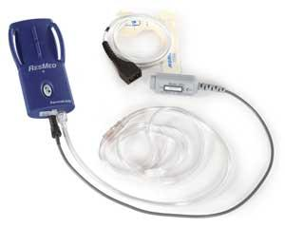
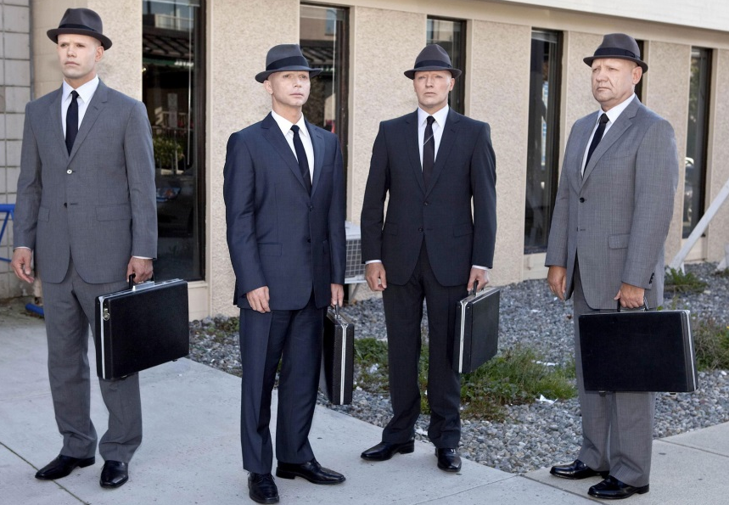
Externally developed
Multiple assessments
Outside experts
Rubrics
Multiple observers
Multiple raters
Internal experts
Assessment Quality

Slide 11
attempt to communicate shared expectations of student performance
Rubric

Slide 12
 |  | Levels of performance
 |  | Below expectations | Approaches expectations | Meets expectations | Exceeds expectations
Components of the outcome | Component A |  | These boxes | would describe
 | Component B |  | observable and | behaviors criteria
 | Component C

Slide 13
Audience will stay awake |  | Levels of performance
 |  | Below expectations | Approaches expectations | Meets expectations | Exceeds expectations
Components of the outcome | Duration | Fell asleep in first 10 minutes | Stayed awake 10-29 minutes | Stayed awake 30 minutes | Didn’t even sleep that night
 | Eyes | Eyes were closed longer than would be expected for a blink | Eyes were open, but eyelids were droopy | Appeared to be looking at slides or presenter most of the time | Except for blinking, maintained eye contact at all times
 | Engagement | Did not pay attention | Paid attention to most, but not all, of the presentation | Appeared to pay attention to the entire presentation | Asked questions for clarification

Slide 14
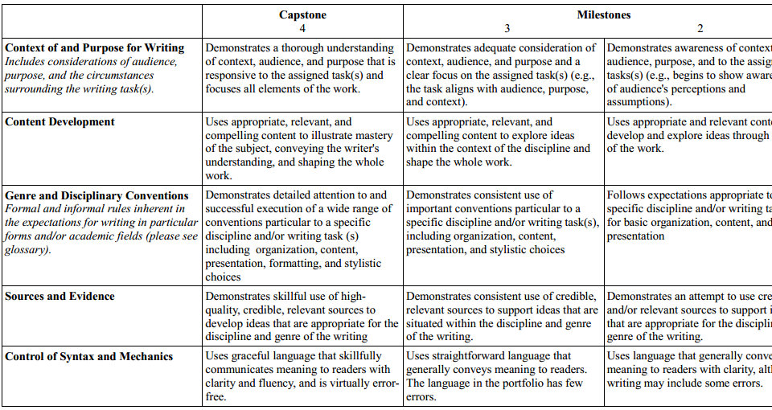

Slide 15
Impact of program activities?
Regardless of student attainment, did our activities contribute?
Student Engagement
Student Satisfaction

Slide 16
Curriculum or Activity Maps
 |  | Program Learning Outcomes
 |  | Outcome #1 | Outcome #2 | Outcome #3
Activities or Curricular Requirements | Course 101 | Introduces outcome Assessed via paper |  | Introduces outcome
 | Activity X | Reinforces outcome | Introduces outcome | Assessed via survey
 | Course 201
 | Capstone experience | Assessed at a mastery level via student projects |  | Reinforces outcome Assessed via student projects

Slide 17
Document & use for improvement
Internal Program Reviews
Strategic Planning
Budgeting

Slide 18
Assessment: How?
?
WASC Re-Accreditation Kick-Off Event & Training
Friday, July 26, 2013

Slide 19
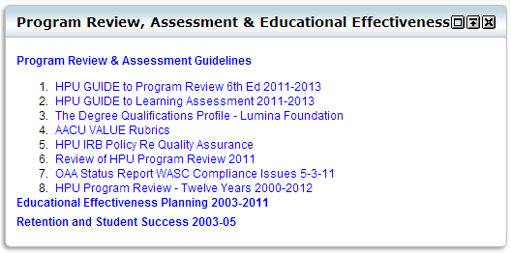
How?

Slide 20
How?
Culture of learning
Culture of assessment

Slide 21
Culture of learning
Students, faculty, staff are all aware of:
CLOs, PLOs, ILOs
How activities contribute to development
What HPU is doing to improve learning
Assessment is intellectually stimulating, sustainable, and useful

Slide 22
How to get there…
I f a t u t r
n r s r c u e

Slide 23
Alignment
HPU mission
Graduation
Satisfaction
Engagement
ILOs
GenEd PLOs
Major PLOs
Co-curricular PLOs
CLOs
CLOs
Activity SLOs
Activity SLOs
CLOs
CLOs

Slide 24
Alignment
Day-to-day
efforts
Institutional
Assessment

Slide 25
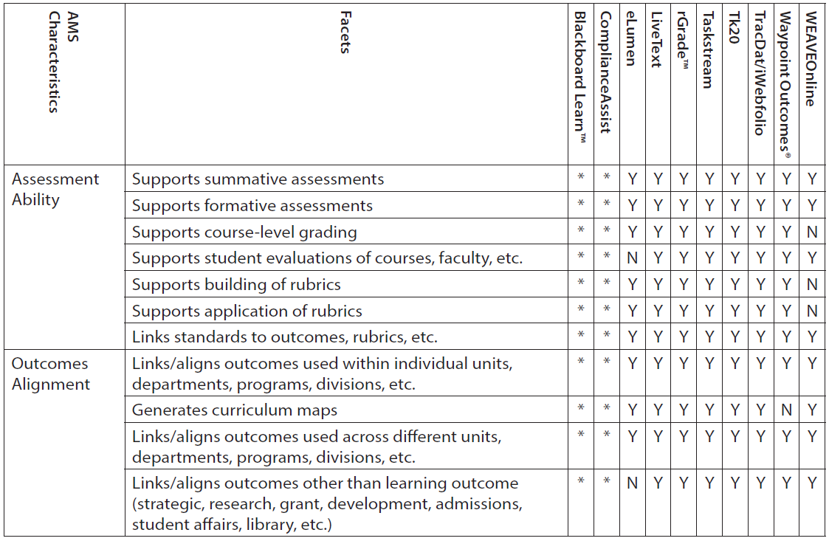
Day-to-day
efforts
Course/activity
assessment
capture
Institutional
assessment
Reflection
+ IR data
Synthesize
+ GenEd assessment
+ external benchmarks
Synthesize
+ Reflect
+ IR Data
+ Planning
Program
Review
Annual
assessment

Slide 26
Assessment: How?
Purpose: To provide useful feedback to benchmark and improve institutional effectiveness.
Values:
* Useful, timely
* Efficient, feasible
* Meets internal and external needs
* Sustained by faculty/staff; supported by leadership
* Synthesizes info from existing and new instruments
* Continuously evaluated and improved

Slide 27
Why?
“… prepare graduates to live, work, and learn as active members of a global society.”
Mission fulfilled?
What contributes?

