Slide 1
Performance Metrics
04.12.2017

Slide 2




1
2
3
4

Slide 5
2016-17
2017-18
CHANGE

Slide 6
Total Score: New College
75
70
59
50

Slide 7
Total Score: New College and other SUS schools
UF
UF
USF
FAU, UCF
UF
UCF
USF
FGCU
FAU
FIU
75
USF
FIU, FSU, UWF
UNF
70
FIU, UCF
FSU
FSU
FGCU
FAMU
FGCU
59
FAMU, UNF
UWF
UNF
FAMU
50
FAU
UWF

Slide 8
Total Score ≤ 50: lose base institutional funding
UF
UF
USF
FAU, UCF
UF
UCF
USF
FGCU
FAU
FIU
75
USF
FIU, FSU, UWF
UNF
70
FIU, UCF
FSU
FSU
FGCU
FAMU
FGCU
59
FAMU, UNF
UWF
UNF
FAMU
50
FAU
UWF

Slide 9
Total Score in bottom 3: no state investment
UF
UF
USF
FAU, UCF
UF
UCF
USF
FGCU
FAU
FIU
75
USF
FIU, FSU, UWF
UNF
70
FIU, UCF
FSU
FSU
FGCU
FAMU
FGCU
59
FAMU, UNF
UWF
UNF
FAMU
50
FAU
UWF

Slide 10
Total Score in top 3: base + state + bonus
UF
UF
USF
FAU, UCF
UF
UCF
USF
FGCU
FAU
FIU
75
USF
FIU, FSU, UWF
UNF
70
FIU, UCF
FSU
FSU
FGCU
FAMU
FGCU
59
FAMU, UNF
UWF
UNF
FAMU
50
FAU
UWF

Slide 11
How’d we do?!?
UF
UF
USF
FAU, UCF
UF
UCF
USF
FGCU
FAU
FIU
75
USF
FIU, FSU, UWF
UNF
70
FIU, UCF
FSU
FSU
FGCU
FAMU
FGCU
59
FAMU, UNF
UWF
UNF
FAMU
50
FAU
UWF

Slide 12
UF
2017-18 (if nothing changes)
UF
UF
USF
FAU, UCF
USF
UF
UWF
FSU
UCF
USF
UCF
FGCU
FAU
FIU
75
USF
FIU, FSU, UWF
UNF
FAU
70
FIU, UCF
FSU
FIU
FSU
FGCU
FGCU
FAMU
FAMU
FGCU
59
FAMU, UNF
UWF
UNF
UNF
FAMU
50
FAU
UWF

Slide 13
UF
2017-18 (if some things change)
UF
UF
USF
FAU, UCF
USF
UF
UWF
FSU
UCF
USF
UCF
FGCU
FAU
FIU
USF
FIU, FSU, UWF
UNF
72
FAU
70
FIU, UCF
FSU
FIU
FSU
FGCU
FGCU
FAMU
FAMU
FGCU
59
FAMU, UNF
UWF
UNF
UNF
FAMU
50
FAU
UWF

Slide 14
UF
2017-18 (we’re in the middle)
UF
UF
USF
FAU, UCF
USF
UF
UWF
FSU
UCF
USF
UCF
FGCU
FAU
FIU
75
USF
FIU, FSU, UWF
UNF
FAU
70
FIU, UCF
FSU
FIU
FSU
FGCU
FGCU
FAMU
FAMU
FGCU
59
FAMU, UNF
UWF
UNF
UNF
FAMU
50
FAU
UWF

Slide 15
Metrics

Slide 16
Metric #1
Percent of Bachelor’s Graduates Enrolled or Employed ($25,000+) in the U.S. One Year After Graduation

Slide 17
Metric #1
Percent of Bachelor’s Graduates Enrolled or Employed ($25,000+) in the U.S. One Year After Graduation
May
2015
Jan. 2016
April 1
June 30
July 31
earn $6,250+*
enroll in a course
receive an overseas scholarship

Slide 18
1: % enrolled, earned $25k+, overseas in 14 months

Slide 19
1: % enrolled, earned $25k+, overseas in 14 months

Slide 20
1: % enrolled, earned $25k+, overseas in 14 months

Slide 21

1: % enrolled, earned $25k+, overseas in 14 months

Slide 22
1: % enrolled, earned $25k+, overseas in 14 months

Slide 23
1: % enrolled, earned $25k+, overseas in 14 months
+12

Slide 24
1: % enrolled, earned $25k+, overseas in 14 months
+53

Slide 25
Metric #2
Median Wages of Bachelor’s Graduates Employed Full-Time in Florida One Year After Graduation

Slide 26
Metric #2
Median Wages of Bachelor’s Graduates Employed Full-Time in Florida One Year After Graduation
Graduating Class of 2015
wages earned from April – June of 2016

Slide 27
Metric #2
Median Wages of Bachelor’s Graduates Employed Full-Time in Florida One Year After Graduation
Graduating Class of 2015
Part-time
earned $4,125 or more
wages earned from April – June of 2016

Slide 28
Metric #2
Median Wages of Bachelor’s Graduates Employed Full-Time in Florida One Year After Graduation
Graduating Class of 2015
4 x median
Part-time
earned $4,125 or more
wages earned from April – June of 2016

Slide 29
2: median wages 14 months after graduating

Slide 30
2: median wages 14 months after graduating

Slide 31
2: median wages 14 months after graduating

Slide 32
What can we do
to help with post-graduation
employment and enrollment?

Slide 33
Metric #3
Cost to the Student:
Net Tuition and Fees per 120 Credit Hours

Slide 34
Metric #3
Cost to the Student:
Net Tuition and Fees per 120 Credit Hours
tuition per credit
+ fees per credit
+ books per credit
credit hours attempted by graduates
sticker price
x
financial aid
scholarships per credit
+ grants per credit
+ waivers per credit
124
credit
hours
x
net tuition & fees

Slide 35
3: net cost to student

Slide 36
3: net cost to student

Slide 37
3: net cost to student

Slide 38
3: net cost to student

Slide 39
Metric #3
Cost to the Student:
Net Tuition and Fees per 120 Credit Hours
tuition per credit
+ fees per credit
+ books per credit
credit hours attempted by graduates
sticker price
x
financial aid
scholarships per credit
+ grants per credit
+ waivers per credit
124
credit
hours
x
net tuition & fees

Slide 40
Metric #4
Six Year FTIC Graduation Rate
FTIC = first time in college
FTIC = students entering with < 12 credits after high school

Slide 41
4: 6-year graduation rate

Slide 42
4: 6-year graduation rate

Slide 43
4: 6-year graduation rate

Slide 44
4: 6-year graduation rate

Slide 45
4: 6-year graduation rate

Slide 46
5: First-to-second year retention rate

Slide 47
How can we help
with retention and
on-time graduation?

Slide 48
Lightning Round

Slide 49
6: STEM, international, environmental studies degrees

Slide 50
7: Percent of students with Pell Grants

Slide 51
7: Percent of students with Pell Grants

Slide 52
8a: Graduate Degrees Awarded in Areas of Strategic Emphasis
8b: % of freshmen in top 10% of high school class

Slide 53
8b: % of freshmen in top 10% of high school class

Slide 54
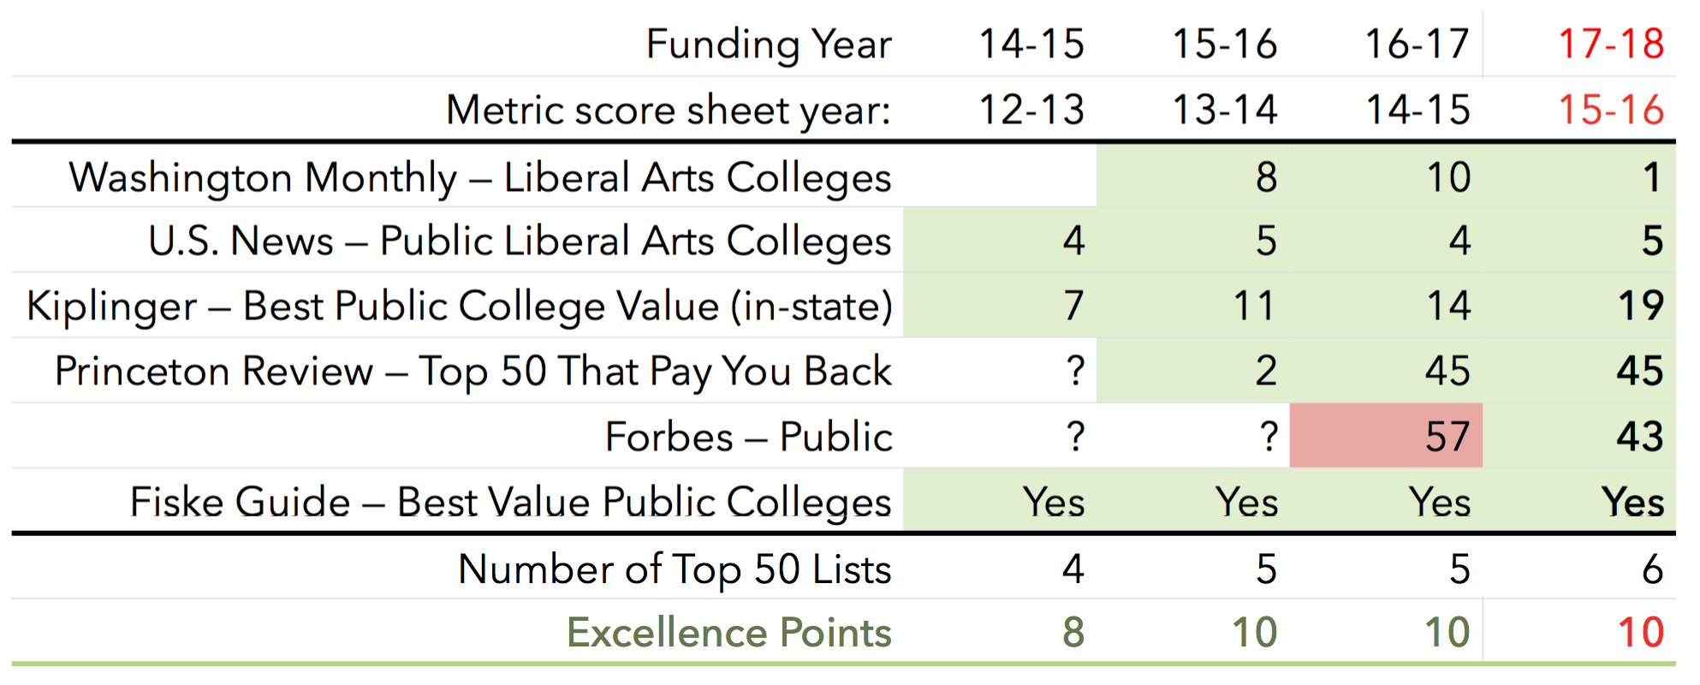
9: BOG Choice — # of (top 50) national rankings

Slide 55
10: BOT Choice:
% of seniors participating in research course

Slide 56
10: Percent of seniors participating in research course

Slide 57
2014-15
2015-16
2016-17
2017-18

Slide 58
2014-15
2015-16
1-2: Post-graduation employment or enrollment
4-5: Graduation and retention rates
2016-17
2017-18

Slide 59
10: Percent of seniors participating in research course

Slide 60
10: By September 1, 2017, each BOT should:
• Choose 3 metrics from SUS Strategic Plan indicators
• Propose excellence benchmarks (1-10)
• Propose improvement benchmarks (1-10)
— prioritized list
— earn no more than 7 points in the first year

Slide 61
10: Percent of alumni donors

Slide 62
10: Percent of alumni donors

Slide 63
10: Percent of alumni donors

Slide 64
10: Percent of alumni donors

Slide 65
10: Percent of seniors participating in research course
10: Percent of students participating in research course
10: Percent of seniors collaborating on research
10: Percent of students publishing/presenting research

Slide 66
10: Percent of seniors completing an internship
Percent of students self-reporting internships: 45-60%
% internship activities appearing on transcript: 25-40%
Percent with transcripted internships

Slide 67
10: Percent of seniors completing 3+ HIPs
High Impact Practices
• Learning communities
• Service- or community-based learning
• Research with faculty
• Internship, practicum, co-op
• Study abroad
• Culminating senior experience

Slide 68
Performance Metrics
04.12.2017

Slide 69
SACSCOC,
Assessment, and You
04.12.2017

